Slide 1
Understanding Urban Traffic Dynamics: Insights from Data Analysis
Mr. Charles Jovans Galiwango
J24M19/002
Department of Computing & Technology
Faculty of Engineering, Design & Technology
Tue 30th April 2024

Slide 2
Research Objectives
Understanding the traffic density on various days of the week in urban environments.
Analyzing the impact of various factors like weather, economic conditions, and vehicle types on traffic density and energy consumption.
Finding the predictor variables that have the most impact on traffic density and energy consumption.

Slide 3
Understanding the traffic density on various days of the week in the urban environments.
To understand how traffic density varies across different days of the week,
I converted the 'Day Of Week' column in the data to a categorical data type using Pandas. This ensures consistent handling of day names and allows for ordered operations like calculating averages.
Then grouped the data by the 'Day Of Week' and calculated the average traffic density for each day.
This analysis helps identify which days of the week experience the highest and lowest traffic congestion in urban environments.

Slide 4
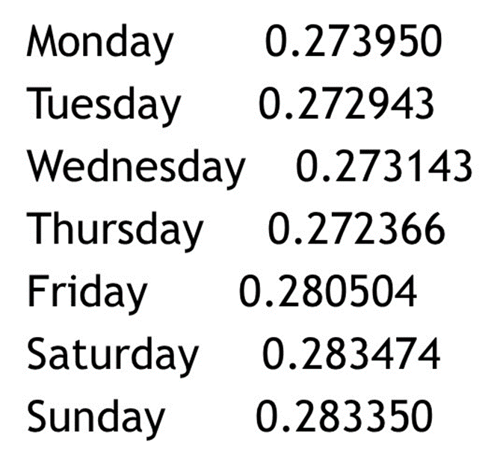
Average Traffic Density by Day of Week

Slide 5
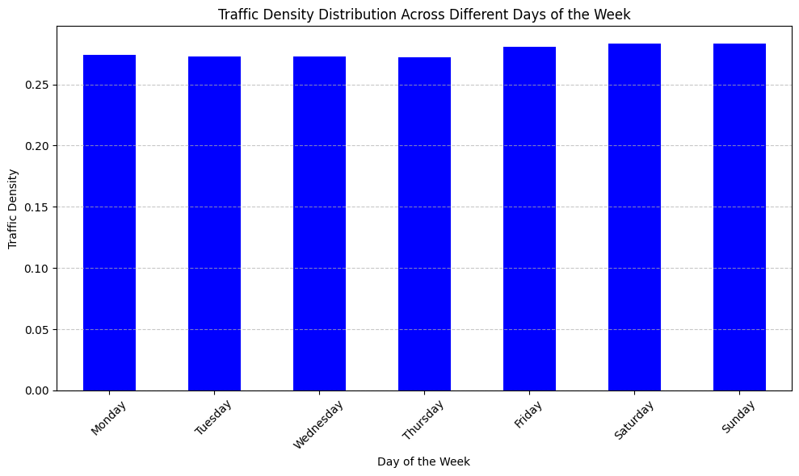

Slide 6
From the results, we can see that traffic density in these cities exhibits a clear weekly pattern. Weekends (Saturday and Sunday) have the highest average traffic density (0.283), followed closely by Friday (0.2805).
This suggests a significant increase in traffic flow compared to weekdays, which have a slightly lower average traffic density

Slide 7
2. Analyzing the impact of various factors like weather, economic conditions, and vehicle types on traffic density and energy consumption

Slide 8
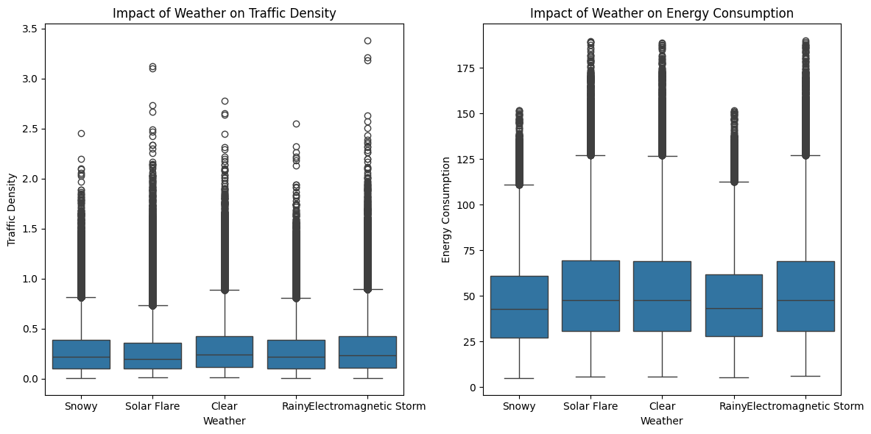
2.1 The Impact of Weather on traffic Density and Energy consumption

Slide 9
Traffic density appears to be higher during rainy and snowy weather conditions, as indicated by the positions of the median lines and the wider spread of the boxes in the left plot.
This suggests that rain and snow may lead to slower speeds and more congestion.
Energy consumption also seems to be potentially affected by weather, with rainy or snowy weather potentially leading to higher energy use, as shown by the possible increase in the median value in the right-hand plot.

Slide 10
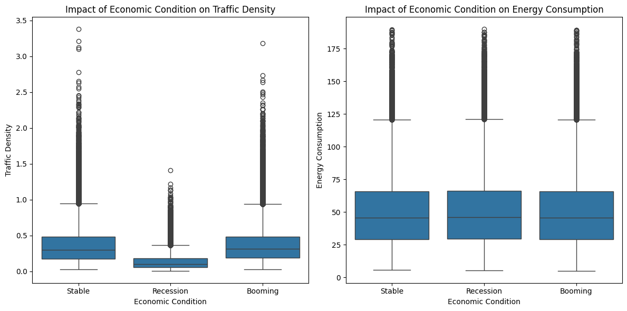
2.2 Analyzing the impact of economic conditions on traffic density and energy consumption

Slide 11
The left plot shows traffic density might be higher during economic booms, as reflected by the potentially higher median and wider spread in the 'Boom' category compared to 'Recession.’
This could be due to increased commercial activity and more people commuting to work during economic prosperity.
The impact on energy consumption seems less clear in the right plot. While there might be some variation in the medians, economic conditions likely affect the total number of vehicles on the road rather than directly influencing energy consumption per vehicle.

Slide 12
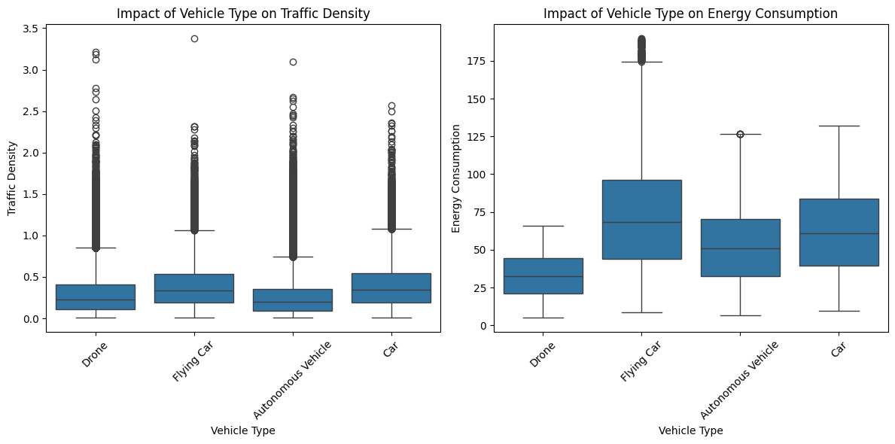
Analyzing the impact of vehicle types on traffic density and energy consumption

Slide 13
Our analysis of vehicle types sheds light on their impact on traffic flow and energy consumption. The left plot suggests that trucks have a significant influence on traffic density, as indicated by the potentially higher median and wider spread in the 'Truck' box compared to others. This aligns with the expectation of larger vehicles causing more congestion. Motorcycles, on the other hand, might have a lower individual impact (reflected by the boxplot) but could be more numerous, affecting overall traffic flow.
When it comes to energy consumption (right plot), trucks again emerge as potential contributors, with a possible higher median in the 'Truck' box. This suggests their size and engine power might lead to higher energy use. Cars, while likely having a lower individual energy consumption per vehicle compared to trucks (depending on fuel efficiency), might be the dominant consumer overall due to their potential abundance (reflected by the spread of the 'Car' box). Motorcycles likely consume less energy per vehicle but their overall impact depends on ridership numbers.

Slide 14
3. Developing and testing traffic density prediction algorithms for smart city solutions.

Slide 15
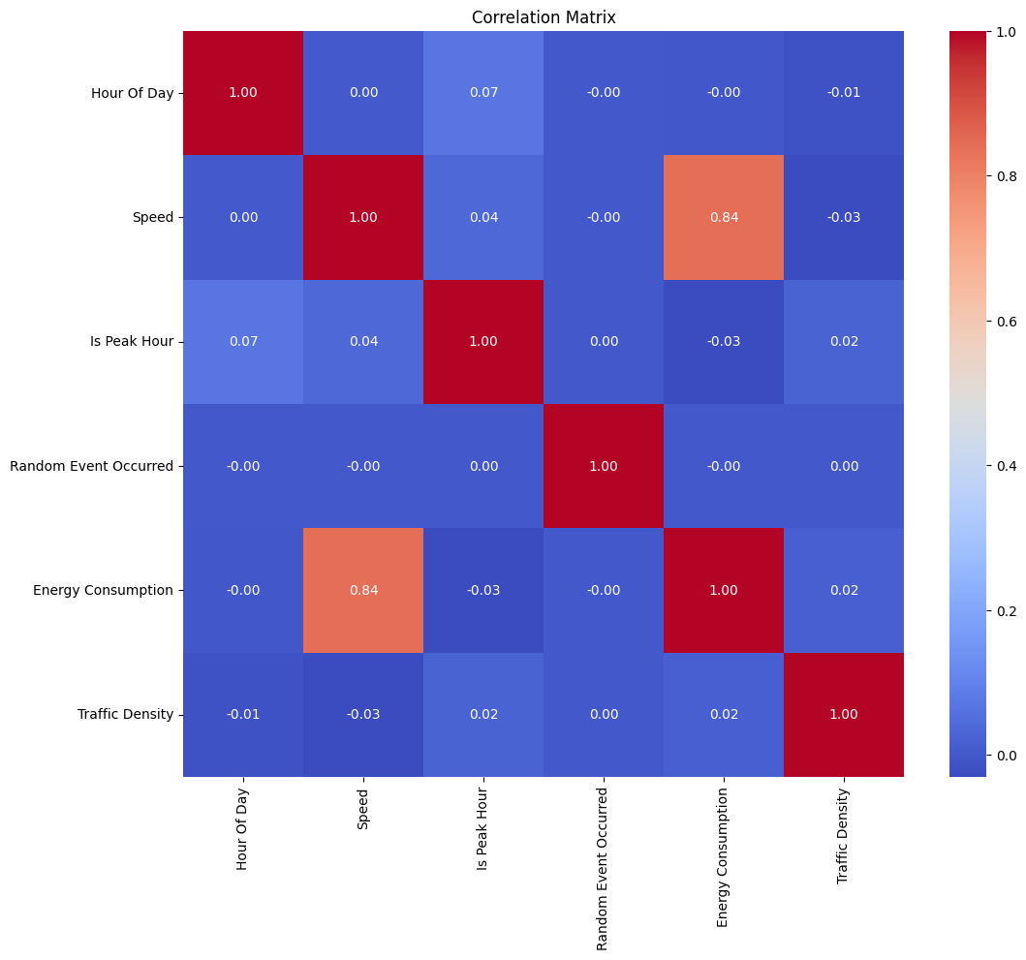
3.1 Finding the predictor variables that have the most impact on traffic density and energy consumption
First came up with a correlation matrix for continuous variables
It indicates that most of the continuous variables don’t correlate with traffic density and only one(speed ) correlates with Energy consumption

Slide 16
3.2 To find a correlation between Traffic Density and the Categorical values
Made use of singleAnova that checks for a correlation between a continuous variable and a categorical variable using a statistical test called one-way ANOVA (Analysis of Variance).
After using that, I came up with a conclusion that ‘City’, 'Vehicle Type', 'Weather', 'Economic Condition’ variables correlate with Traffic Density

Slide 17
3.3 Model building and Selection
To select the best model for predicting traffic density, I evaluated several models using three key metrics: Mean Squared Error (MSE), Mean Absolute Error (MAE), and R-squared
Lower MSE indicates a better fit, as smaller errors are squared less harshly.
MAE measures the average of the absolute differences between predicted and actual traffic density values.
R-squared value ranges from 0 to 1, with a higher value indicating a better fit.

Slide 18
Results from the different Models
Linear Regression
Mean Squared Error: 0.042956664265291
Mean Absolute Error: 0.163337652922051
R-squared: 0.10689116464458481
Random Forest
Mean Squared Error: 0.012550042013989803
Mean Absolute Error: 0.07211004577134217
R-squared: 0.7390730030256918
GradientBoostingRegressor
Mean Squared Error: 0.013220661519542709
Mean Absolute Error: 0.07610824278478828
R-squared: 0.7251302023959203
Based on the above evaluation, Random Forest appears to be the most suitable model for predicting traffic density. It offers the best balance of low error (both squared and absolute) and high explanatory power (capturing traffic density variations effectively).

